Slide 1
Assignment 17
Erstyna – Data Analytics Student
01

Slide 2
1. Identify the top 10 customers and their email so we can reward them

Slide 3
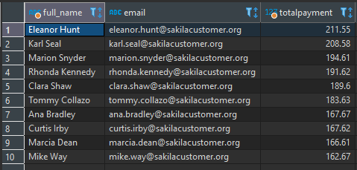
Written SQL Query
Written SQL Query
Query Result (Screenshoot)
select concat(customer.first_name, ' ', customer.last_name) as full_name, customer.email,
sum(amount) as totalpayment
from payment
join customer
on payment.customer_id = customer.customer_id
group by customer.customer_id
order by totalpayment desc
limit 10

Slide 4
Visuali-zation

Slide 5
2. Identify the bottom 10 customers and their emails

Slide 6
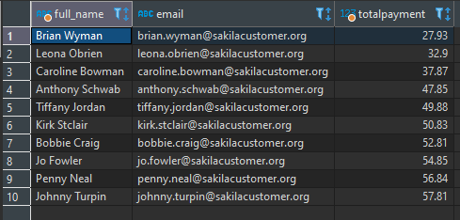
Written SQL Query
Written SQL Query
Query Result (Screenshoot)
select concat(customer.first_name, ' ', customer.last_name) as full_name, customer.email,
sum(amount) as totalpayment
from payment
join customer
on payment.customer_id = customer.customer_id
group by customer.customer_id
order by totalpayment asc
limit 10

Slide 7
Visuali-zation

Slide 8
3. What are the most profitable movie genres (ratings)?

Slide 9
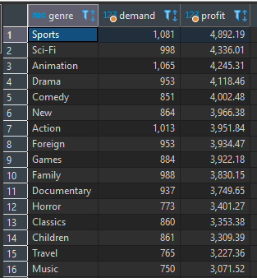
Written SQL Query
Written SQL Query
Query Result (Screenshoot)
select category.name as genre, count(payment.customer_id) as demand,
sum(amount) as profit
from payment, rental, inventory, film_category, category
where payment.rental_id = rental.rental_id
and rental.inventory_id = inventory.inventory_id
and inventory.film_id = film_category.film_id
and film_category.category_id = category.category_id
group by category.name
order by profit desc

Slide 10
Visualization (Genres)

Slide 11
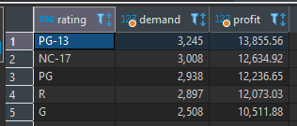
Written SQL Query
Written SQL Query
Query Result (Screenshoot)
select film.rating, count(payment.customer_id) as demand,
sum(amount) as profit
from payment, rental, inventory, film
where payment.rental_id = rental.rental_id
and rental.inventory_id = inventory.inventory_id
and inventory.film_id = film.film_id
group by film.rating
order by profit desc

Slide 12
Visualization (Ratings)

Slide 13
4. How many rented movies were returned late, early, and on time?

Slide 14
Written SQL Query
create table "daysrent"
as select rental.rental_id, film.film_id,
film.rental_duration,
extract(day from age(return_date, rental_date)) as days_rent,
(case
when extract(day from age(return_date, rental_date)) < rental_duration then 'Early’
when extract(day from age(return_date, rental_date)) = rental_duration then ‘On Time’
else ‘Late'
end) as category
from rental, film, inventory
where film.film_id = inventory.film_id
and inventory.inventory_id = rental.inventory_id

Slide 15
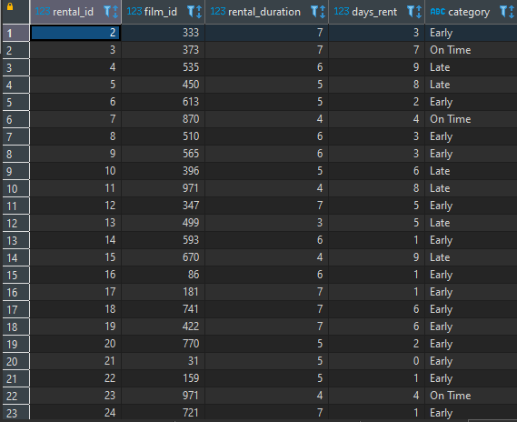
Query Result (Screenshoot)

Slide 16

Written SQL Query
Query Result (Screenshoot)
select category as return_status, count(category) as total
from daysrent
group by daysrent.category

Slide 17
Visuali-zation

Slide 18
5. What is the customer base in the countries where we have a presence?

Slide 19
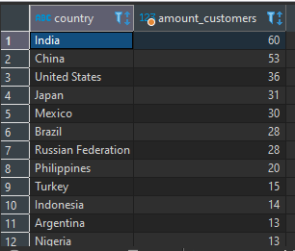
Written SQL Query
Written SQL Query
Query Result (Screenshoot)
select distinct country,
count(customer_id) as amount_customers
from customer, country, address, city
where customer.address_id = address.address_id
and address.city_id = city.city_id
and city.country_id = country.country_id
group by country.country
order by amount_customers desc

Slide 20
Visuali- zation

Slide 21
6. Which country is the most profitable for the business?

Slide 22
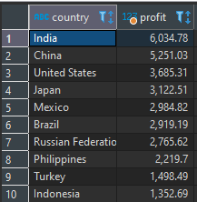
Written SQL Query
Written SQL Query
Query Result (Screenshoot)
select country.country, sum(amount) as profit
from payment, country, city, address, customer
where country.country_id = city.country_id
and city.city_id = address.city_id
and address.address_id = customer.address_id
and customer.customer_id = payment.customer_id
group by country.country
order by profit desc
limit 10

Slide 23
Visualiza-tion

Slide 24
7. What is the average rental rate per movie genre (rating)?

Slide 25
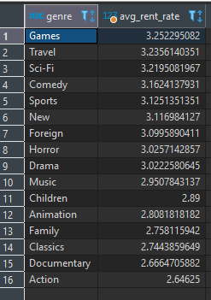
Written SQL Query
Query Result (Screenshoot)
select category.name as genre,
avg(film.rental_rate) as avg_rent_rate
from film, film_category, category
where film.film_id = film_category.film_id
and film_category.category_id = category.category_id
group by category.name
order by avg(film.rental_rate) desc

Slide 26
Visuali-zation

Slide 27

Written SQL Query
Written SQL Query
Query Result (Screenshoot)
select film.rating,
avg(rental_rate) as average_rate
from film
group by film.rating

Slide 28
Visuali-zation

Slide 29
Thank you!

